Slide 1


Global Nutrition and Health: Analyzing the Relationship Between Diet Composition and Disease Prevalence
Meme Habel
Yichen Qin and Ruth Seiple

Slide 2



Introduction
vs.
Notes:
As we all know, cultures around the world differ in many ways. When visiting other countries, one may notice dissimilarities in clothing, language, architecture, work- ethic, and much more relative to their home country. However, a critical source of variation among regions is nutrition. Dietary habits are deeply rooted in cultural, historical, and environmental factors, shaping the health and well-being of populations.
For instance, a Mediterranean diet is typically comprised primarily of plant products such as fruits, vegetables, nuts, whole grains, and legumes with limited processing (McManus). Conversely, the standard American diet involves more animal products, particularly meat, as well as carbohydrates (“Mediterranean Diet.”).

Slide 3
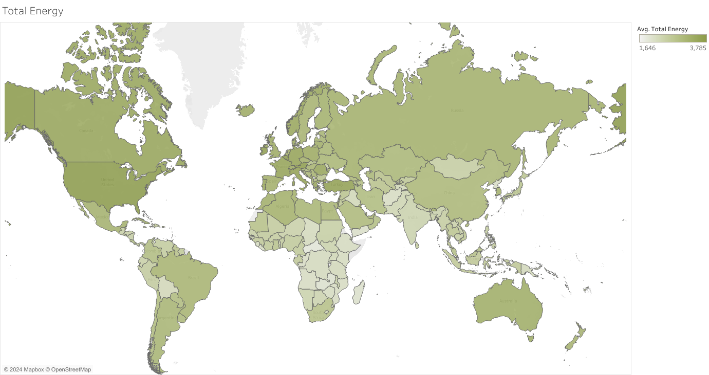
Problem Description
Understand the impact of diet composition and lifestyle habits on disease prevalence.
Average Daily Total Energy (kcal)
Graphic Developed in Tableau
Notes:
In this capstone project, I intend to explore the average macronutrient compositions and caloric intake by country. This analysis will involve examining the distribution of macronutrients (proteins, fats, and carbohydrates) and overall caloric consumption, providing a comprehensive overview of dietary patterns globally. Following an initial assessment of this nutritional data, I will investigate the prevalence of various disease categories in each country to identify the most common health issues. The core of this project lies in integrating dietary data with health outcomes to uncover significant insights. By leveraging advanced modeling techniques I have learned throughout both my undergraduate and graduate studies in Business Analytics,
I will explore potential correlations between regional diet compositions and disease risks.
Additionally, to provide a more holistic understanding of the factors influencing health outcomes, I will further explore data on other lifestyle factors such as alcohol consumption and physical activity.

Slide 4
Data Definitions
Macronutrient Composition:
Location_id *primary key
Country
Year
total_energy (kcal)
avg_total_fat (g)
avg_total_protein (g)
avg_total_carbohydrates (g)
avg_energy_from_animal_products (kcal)

Slide 5
Data Definitions
Diseases:
Location_id *primary key
Location_name (country)
Cause_id
Cause_name (disease name)
Prevalence_Rate: Total cases per 100,000 population
Death_Rate: Deaths per 100,000 population
DALY_Rate: Disability adjusted life years (DALYs) per 100,000 population
Note: DALY = The sum of years lost due to premature death (YLLs) and years lived with disability (YLDs). One DALY equals one lost year of healthy life.

Slide 6
Data Definitions
Alcohol Consumption:
Location_id *primary key
Year
Beverage_Type (Beer, Wine, Spirits, Other alcoholic beverages, or All types)
Alc_consumption_per_capita
Physical Activity:
Location_id *primary key
Year
Percent_insufficient_phys_activity (Percent of population attaining less than 150 minutes of moderate-intensity physical activity per week, or less than 75 minutes of vigorous-intensity physical activity per week, or equivalent.)

Slide 7
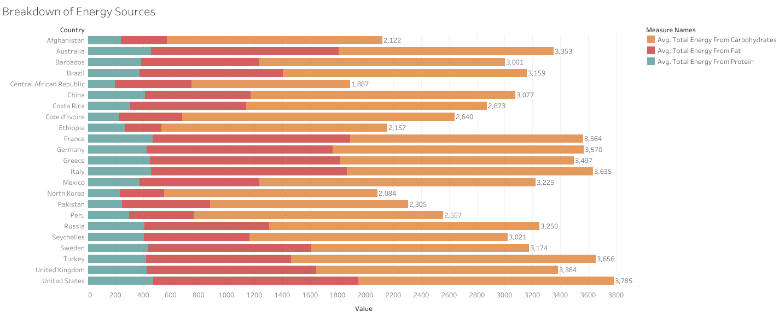
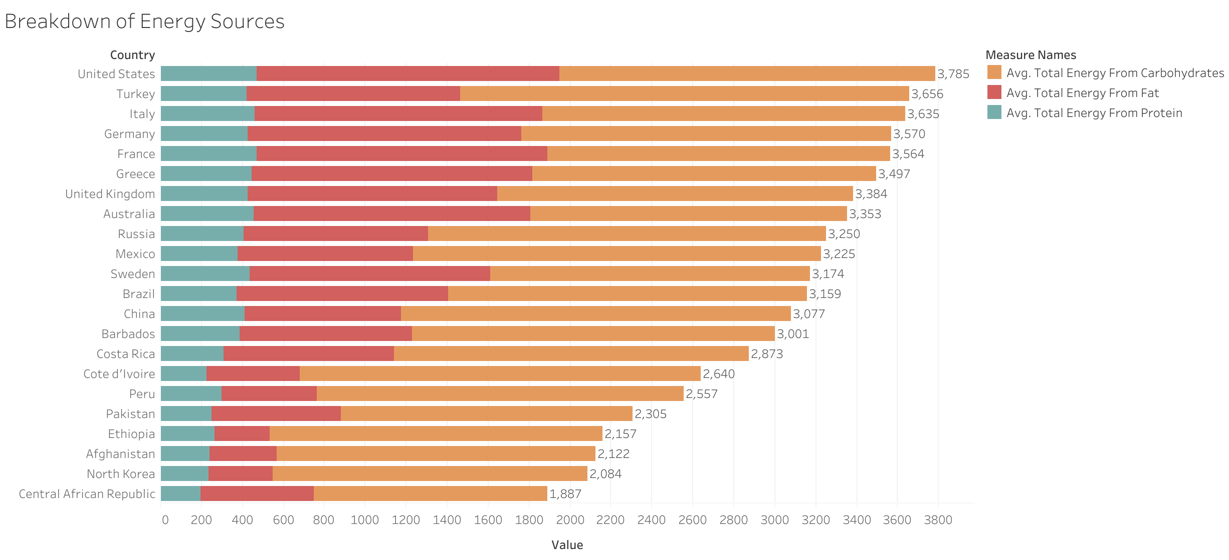
Average Daily Energy Composition
Graphic Developed in Tableau

Slide 8
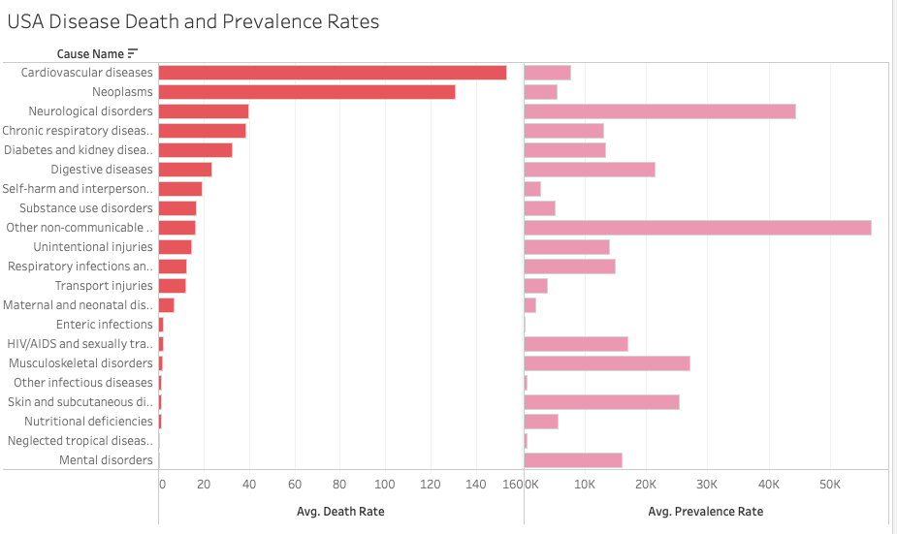
USA Disease Death and Prevalence Rates
Graphic Developed in Tableau

Slide 9
Model Setup
K-Folds Cross-Validation
K = 10
Min-Max Normalization
Range: [0,1]
Recursive Feature Elimination (RFE)
Backwards feature selection algorithm
Evaluation Metrics:
Mean Squared Prediction Error (MSPE)
Mean Absolute Error (MAE)
R-squared
Types of models:
Multiple Linear Regression
Random Forests
Notes:
K-folds Cross validation since only 124 rows of data, so didn’t want to split into test and train data. I used 10 folds for the cross validation. Then, since the different variables were on rather different scales, I normalized the data using min-,max normalization so all data values range from 0 to 1. For the interpretation of my linear model, however, I transformed the model coefficients back to the original scales for interpretation purposes.
For all models, I used a Recursive Feature Elimination or RFE function which is just a simple backwards feature selection algorithm. This allowed me to only use the most important feature variables to improve accuracy of my models.
Mean Squared Prediction Error (MSPE): expected squared distance between what your predictor predicts for a specific value and what the true value is (lower is better)
Mean Absolute Error (MAE): average of absolute errors (lower is better)
R-squared: evaluates how well the model explains the variability in the data. (higher is better)
Finally, for each disease group I produced a multiple linear regression model and a random forests model.

Slide 10
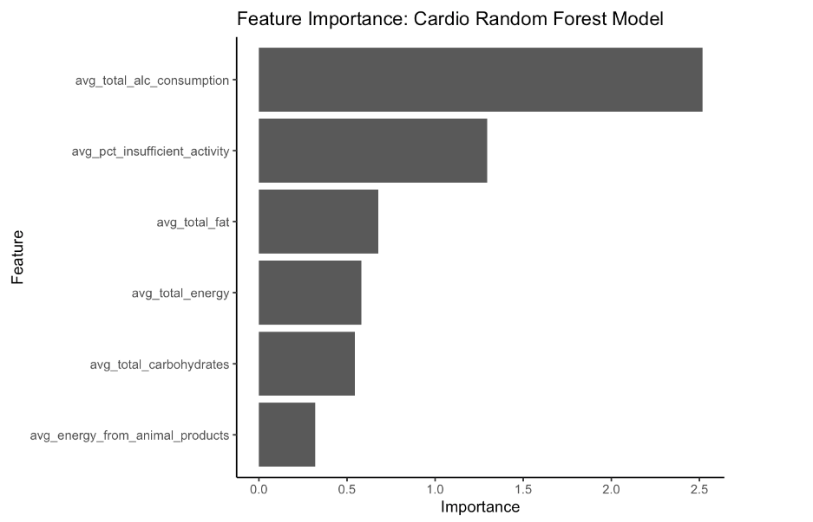
Cardiovascular Diseases Target Variable: Average Disease Prevalence Rate
Linear Regression Model
Predictors and Coefficients
avg_total_alc_consumption:
-182.302717***
avg_energy_from_animal_products:
0.197004
MSPE: 0.04210
MAE: 0.1654
R-Squared: 0.1594
Random Forest Model
MSPE: 0.03643
MAE: 0.1548
R-Squared: 0.2781

Slide 11
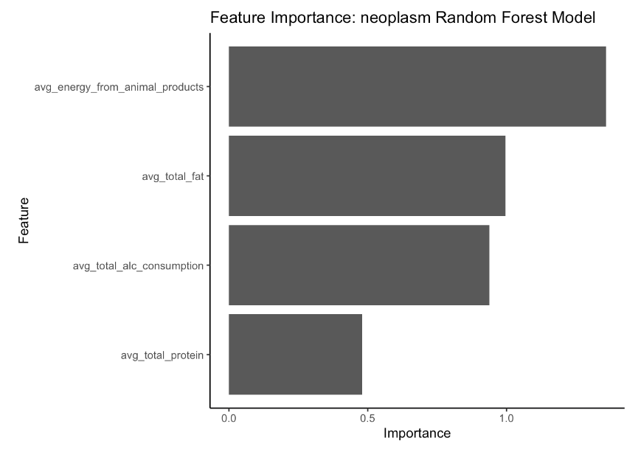
Neoplasms Target Variable: Average Disease Prevalence Rate
Linear Regression Model
Predictors and Coefficients
avg_total_alc_consumption:
14.85078***
avg_total_fat:
92.39680***
MSPE: 0.01164
MAE: 0.07863
R-Squared: 0.6411
Random Forest Model
MSPE: 0.01203
MAE: 0.07709
R-Squared: 0.6287

Slide 12
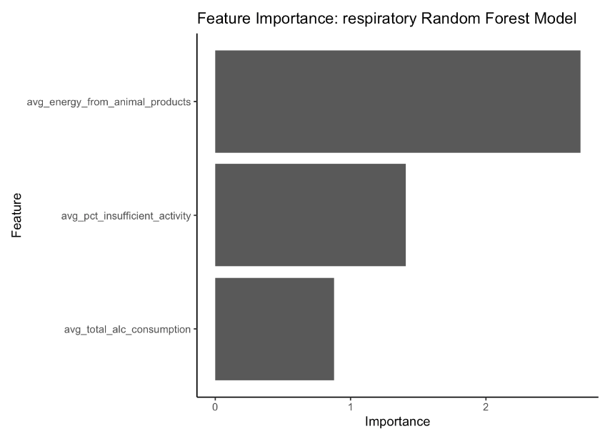
Chronic Respiratory Diseases Target Variable: Average Disease Prevalence Rate
Linear Regression Model
Predictors and Coefficients
avg_energy_from_animal_products:
3.914034***
avg_pct_insufficient_activity:
59.496601***
MSPE: 0.02671
MAE: 0.1276
R-Squared: 0.3626
Random Forest Model
MSPE: 0.02184
MAE: 0.1167
R-Squared: 0.4816

Slide 13
Conclusions
Energy from animal products → higher risk of Cardiovascular and Chronic Respiratory Diseases
Alcohol Consumption → higher risk for Neoplasms
Insufficient Physical Activity → higher risk for Chronic Respiratory Diseases
Large total daily fats consumption → higher risk for Neoplasms

Slide 14
References
“Gho | by Category | Recorded Alcohol per Capita Consumption, from 2010 - Updated May 2021.” World Health Organization, World Health Organization, apps.who.int/gho/data/node.main.A1039?lang=en. Accessed 1 July 2024.
Global Burden of Disease Collaborative Network. Global Burden of Disease Study 2021 (GBD 2021). Seattle, United States: Institute for Health Metrics and Evaluation (IHME), 2024.
“Prevalence of Insufficient Physical Activity among Adults Aged 18+ Years (Age-Standardized Estimate) (%).” World Health Organization, World Health Organization, www.who.int/data/gho/data/indicators/indicator-details/GHO/prevalence-of-insufficient-physical-activity-among-adults-aged-18-years-(age-standardized-estimate)-(-).
Ritchie, Hannah, et al. “Diet Compositions.” Our World in Data, 28 Dec. 2023, ourworldindata.org/diet-compositions.

